Slide 1
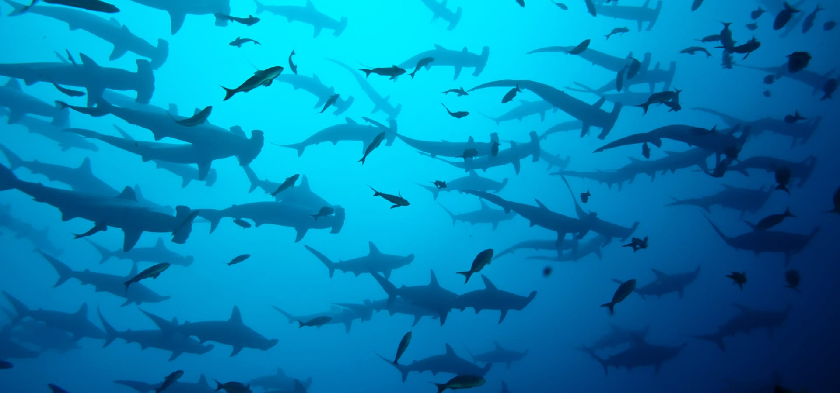
How to breathe underwater
Nina Munoz

Slide 2
Before We Get Started…

Slide 3
Chasing Coral – Full Movie on YouTube and Netflix
https://www.youtube.com/watch?v=aGGBGcjdjXA

Slide 4
Today we will cover…
A Brief History of Diving
Physics of Diving
Talking to Fish
Saving the Ocean

Slide 5
A Brief History of SCUBA Diving
Earliest Diving – A Timeline
Diving Today

Slide 6
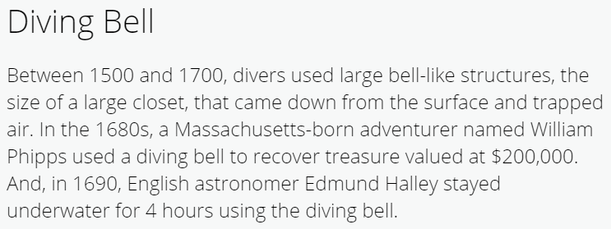
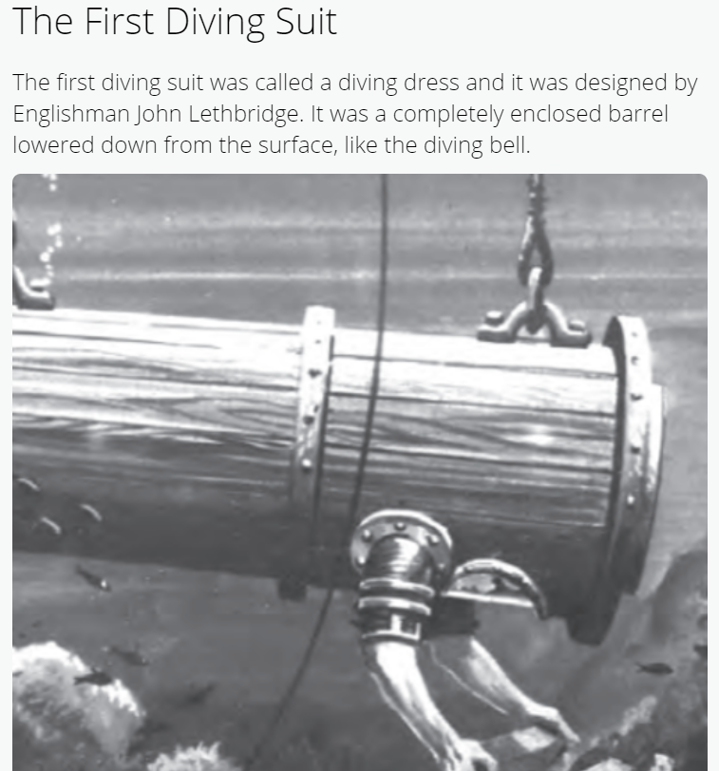
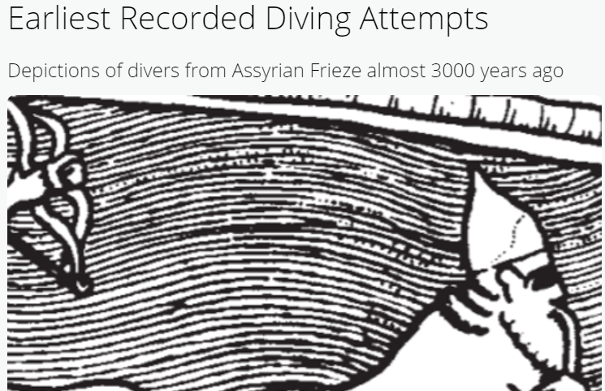
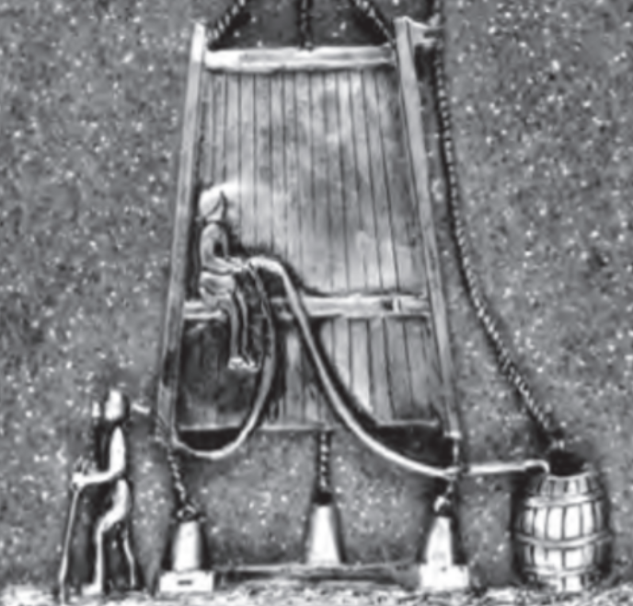
Earliest Diving – A Timeline
3000 YEARS AGO
~500 YEARS AGO
300 YEARS AGO
Notes:
https://www.youtube.com/watch?v=-8F0YO4hMcw

Slide 7
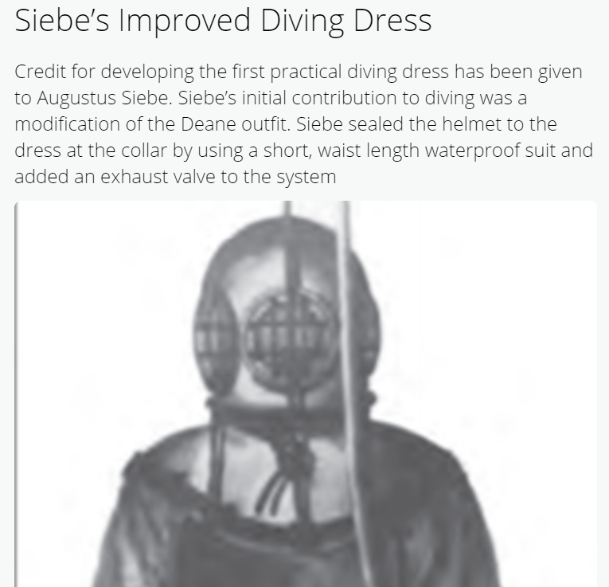
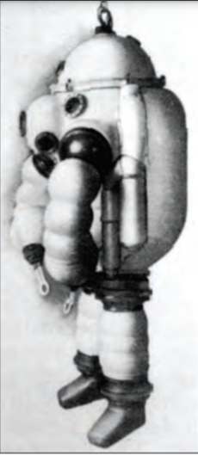
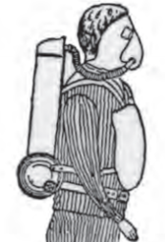
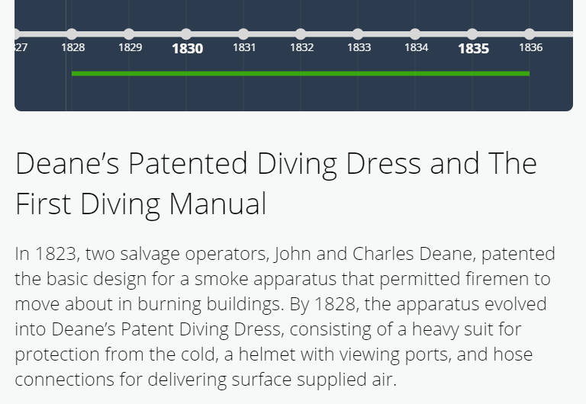
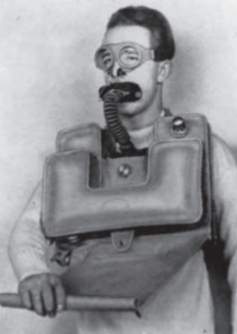
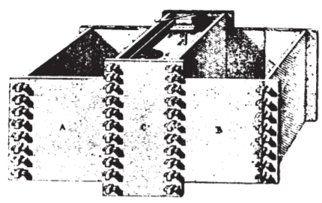
Earliest Diving – A Timeline
190 YEARS AGO
180 YEARS AGO
AND EVERYTHING INBETWEEN…
Notes:
https://www.youtube.com/watch?v=-8F0YO4hMcw

Slide 8
Diving Today
Organizations – PADI, NAUI, SSI
Statistics – 6 million active divers, 39% female.
Exploration – > 80% of the world’s oceans unmapped.
Freediving, warm-water diving, dry-suit diving, ice diving, and cave diving
Notes:
Sources:
Scuba divers worldwide: https://www.dema.org/store/download.aspx?id=7811B097-8882-4707-A160-F999B49614B6
Unexplored ocean: https://oceana.org/blog/why-does-so-much-ocean-remain-unexplored-and-unprotected#:~:text=More%20than%2080%25%20of%20the,marine%20protected%20areas%20(MPAs).
One of the most amazing things about scuba diving is that it is a combination of science and the arts – physics, chemistry, environmental science, biology, sports, physical education, cartography, photography, the list goes on. It is also an activity that has much to be explored and discovered – much of the science behind the deepest dives has yet to be explained, and most of the ocean is still a complete mystery.

Slide 9
Organizations

Slide 10
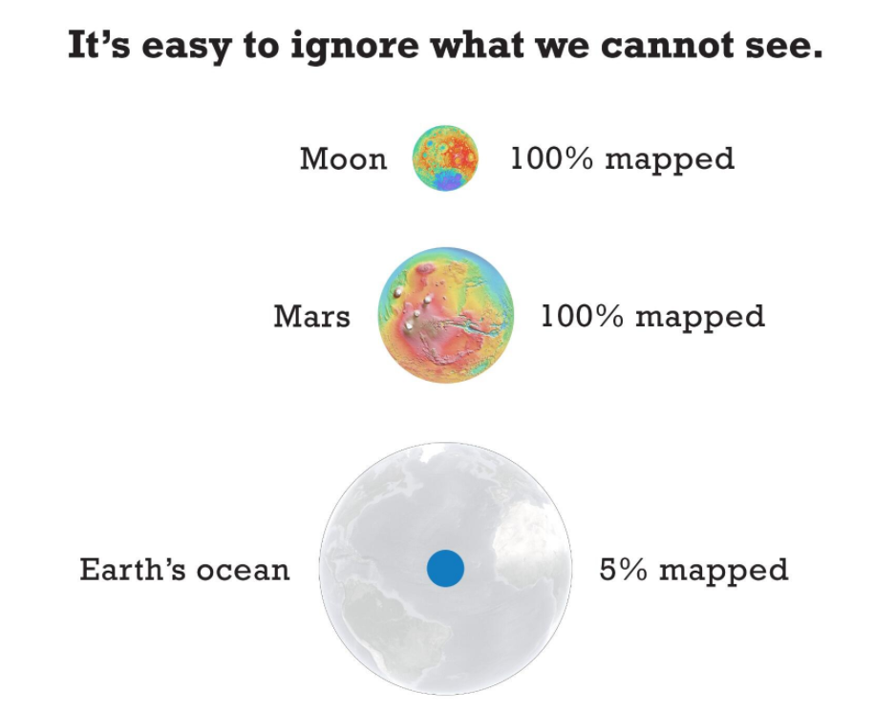
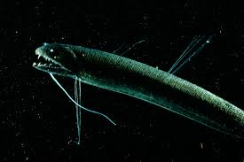
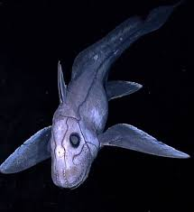
Exploration

Slide 11
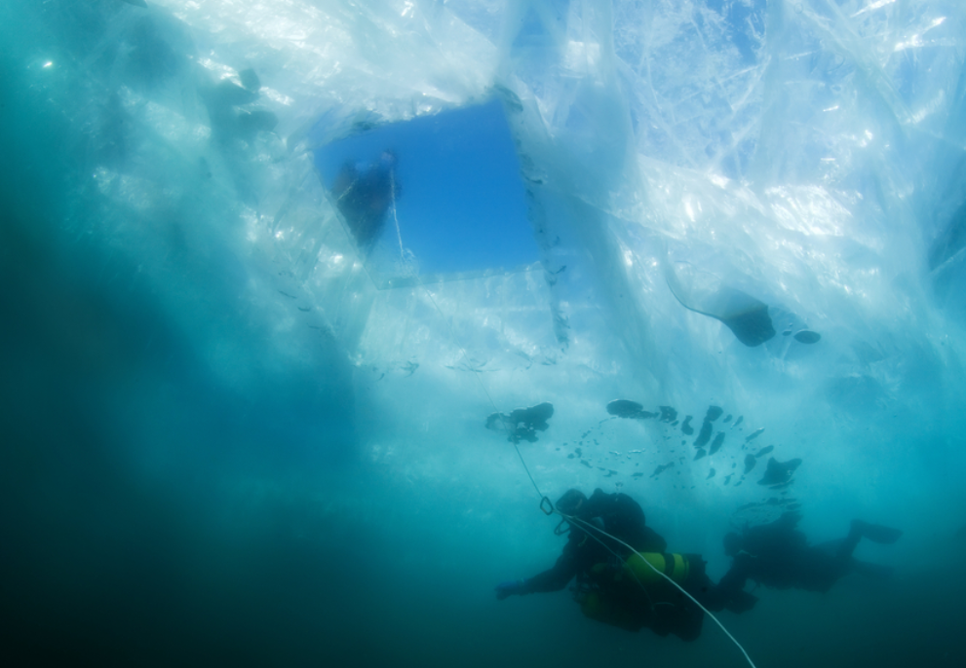
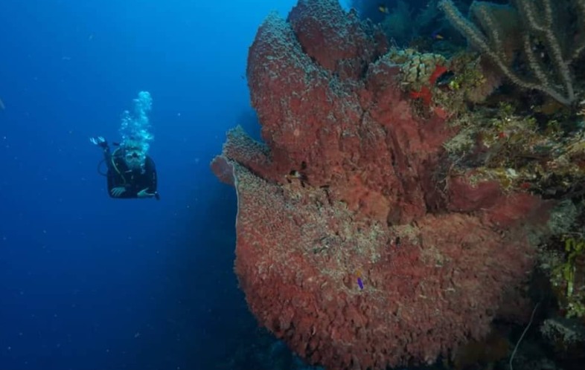
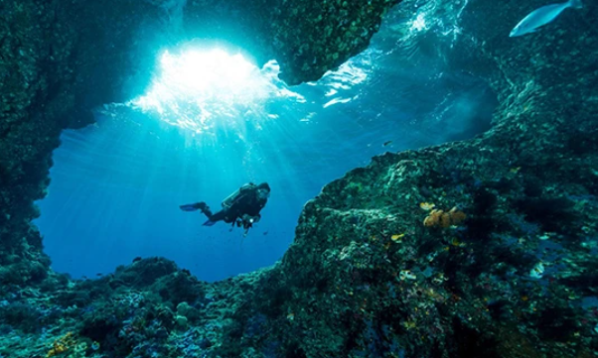
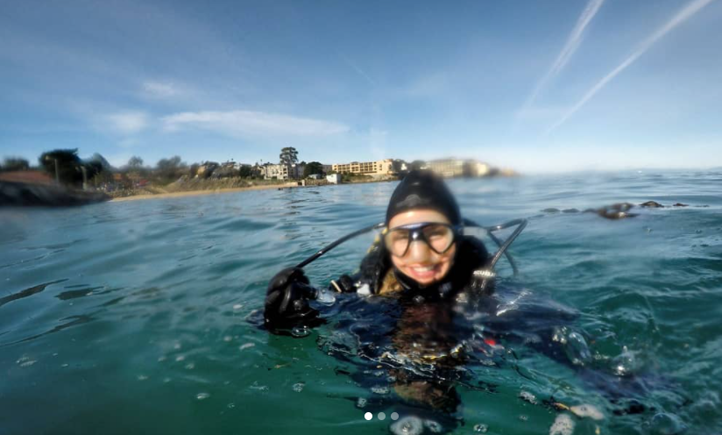
Types of Diving
Warm Water Diving
Ice Diving
Dry Suit Diving
Cavern / Cave Diving

Slide 12
The Physics of Diving
How We Breathe Underwater
The Suds and Nitrogen Narcosis
Amazing Physical Feats

Slide 13
Breathing Underwater
Pneumatics - Tanks filled with compressed air
The “regulator” regulates the pressure for us to breath
Our constant breathing allows us to exhale excess air as we ascend
Boyle’s Law - We breath twice as much air at 33 ft, or 2 “atmospheres.”
Notes:
Before we dive, metal tanks are filled with compressed air, which means the air stays at a constant pressure when it’s in the tank. The study of compressed air is called Pneumatics, it is actually its own field!
The tanks are filled with air at the proportion that we breath it on land. It is typically 78% nitrogen, 21% oxygen, 1% other gasses.
When we go underwater, we are breathing this air. It passes through a device, called a regulator, which regulates the pressure so that when you breath the air in, you breath it at the pressure you are under. It feels as easy as breathing air right now!
The pressure you are under is measured in “atmospheres,” or ATMs. At sea level, or where we all are right now, we are under 1 atmosphere of pressure. 33 feet is equal to one “atmosphere,” so once you are under 33 feet of water, you have the weight of 2 atmospheres on top of you!
If you were to try to bring a bag full of air underwater, it would get crushed under the pressure. Metal tanks are about an inch thick and are tested under extremely high pressures to make sure they don’t dent.
One important thing about diving is that it is not as easy as just going up and down. When you are diving, as I mentioned, you are breathing compressed air because you are under the weight of the water. Just as a bag would crumple under pressure, it will expand again when it is not under pressure! Humans are the same way.
When you are coming to the surface from a dive, as you ascend, you are breathing out “more” compressed air, and breathing in “less” compressed air. This prevents you from exploding, by preventing you from rising with extremely compressed air that expands inside of you! Instead, you rise with air that is less and less compressed, until you are at the surface breathing in air that is only compressed to 1 atmosphere.

Slide 14
Decompression Sickness “The Suds” & Nitrogen Narcosis
Henry’s Law – Solubility of gas is linked to pressure and temperature
Nitrogen dissolves into our blood when we dive, especially at depth.
When we ascend slowly, excess Nitrogen escapes through breath
Decompression sickness = Nitrogen escaping through our blood!

Slide 15
Amazing Physical Feats (Unexplained!)
Deepest Freedive (breath-holding) – 710 ft by Herbert Nitsch, Austria
Deepest SCUBA dive – 1090 ft by 41-year-old Ahmed Gabr, Egypt
Notes:
Our bodies were not meant to be underwater, but our bodies will also not be “crushed” by the effects of diving because pressure has no effect on water. However, our circulatory and renal systems and fluid balance are affected by the hydrostatic pressure of SCUBA diving against our internal hydrostatic pressure of the blood. For this reason, blood is usually sent to your heart and brain, and one reason why it is important to keep your core warm while you dive. Fluid loss can also occur due to diving physiology. Do you get the urge to pee when you get in the water? This is something known as immersion diuresis which is caused by the body detecting an increase in blood pressure leading to the need to urinate.

Slide 16
Talking to Fish
Sharks: Interacting with Sharks, Sharks and Our Ecosystem
Whales: Whale Communication

Slide 19
WHAT TO DO IF YOU ENCOUTER A SHARK
Wear Dull Colors
If You Don’t Want to Take Your Chances…
Sharks are less likely to approach you underwater than if you’re at the surface
Direct its Nose
If a Shark Comes too Close for Comfort…
Normally, it is advised never to touch anything you encounter underwater
Relax!
Most Sharks are Just Saying Hello ☺
If necessary, forcefully (but not violently!) direct the shark in a different direction. They are only approaching you to see what you are, but they smell with their mouths ☺
If you really don’t want to be approached, don’t wear anything too light (light pink, white, neon). Most colors become extremely dull underwater, but not all!

Slide 20
Ocean Ramsey – Why the World Needs Sharks
https://www.ted.com/talks/ocean_ramsey_why_the_world_needs_sharks/transcript?language=en
Notes:
https://blog.padi.com/2018/06/06/learning-shark-communication-with-ocean-ramsey/

Slide 21
Notes:
Whales are very social creatures that travel in groups called “pods.” They use a variety of noises to communicate and socialize with each other. The three main types of sounds made by whales are clicks, whistles, and pulsed calls.
Clicks are believed to be for navigation and identifying physical surroundings. When the sound waves bounce off of an object, they return to the whale, allowing the whale to identify the shape of the object. Clicks can even help to differentiate between friendly creatures and predators. Clicks have also been observed during social interactions, suggesting they may also have a communicative function.
Whistles and pulsed calls are used during social activities. Pulsed calls are more frequent and sound like squeaks, screams, and squawks to the human ear. Differing vocal “dialects” have been found to exist between different pods within the same whale population. This is most likely so that whales can differentiate between whales within their pods and strangers.
Whales also use their tails and fins to make loud slapping noises on the surface of the water to communicate nonverbally. The sound can be heard for hundreds of meters below the surface and may be a warning sign of aggression or a tool to scare schools of fish together, making them an easier meal.
In the Stellwagen Bank National Marine Sanctuary, NOAA scientists attached sensors to whales in order to track their movement patterns. They hope to learn about the whales’ behavior and communication as well as to observe how human interaction affects their behavior.

Slide 22
Whale Sounds (Link)
Clicks
Navigation and Physical Surroundings
When the sound waves bounce off of an object, they return to the whale, allowing the whale to identify the shape of the object. Clicks can even help to differentiate between friendly creatures and predators.
Whistles
Social Interactions
Whistles are mostly used for social interactions between whales, to communicate with one another.
Pulsed Calls
Whale Dialects
Pulsed calls sound like squeaks, screams, and squawks to humans underwater. Whales use them to differentiate between whales within their own pods and strangers,

Slide 23
Saving the Ocean
What is Happening to the Ocean
How We Can Help

Slide 24
THE OCEAN IS DYING
Coral Reefs
A temperature change in the ocean caused by climate change has resulted in immense destruction. Greenhouse gasses get dissolved into the oceans at 93%. 50 percent of the world's coral reefs have died in the last 30 years and up to 90 percent may die within the next century.
By 2050, plastic in the oceans will outweigh fish, predicts a report from the Ellen MacArthur Foundation, in partnership with the World Economic Forum. The report projects the oceans will contain at least 937 million tons of plastic and 895 million tons of fish by 2050.
We use coral reefs for medicine, to prevent natural disasters, for global economies, and for survival.
Collapsing Ecosystem
Notes:
122 Farenheit would be the temperature if

Slide 25
WHY IS THIS HAPPENING?
Greenhouse Gasses
Transportation and agriculture are two of the leading causes of greenhouse gas emissions globally, as well as general electricity and home heating/cooling.
Plastic Debris
Single-use plastic is one of the leading contributors, as well as microplastics in fabrics, and discarded fishing nets
Overfishing and Bycatch
Most of the ocean is unprotected because it does not “belong” to any one nation. Many large fishing vessels will go to these areas and fish illegally; there are also very few regulations in place globally to fish at a sustainable pace.

Slide 26
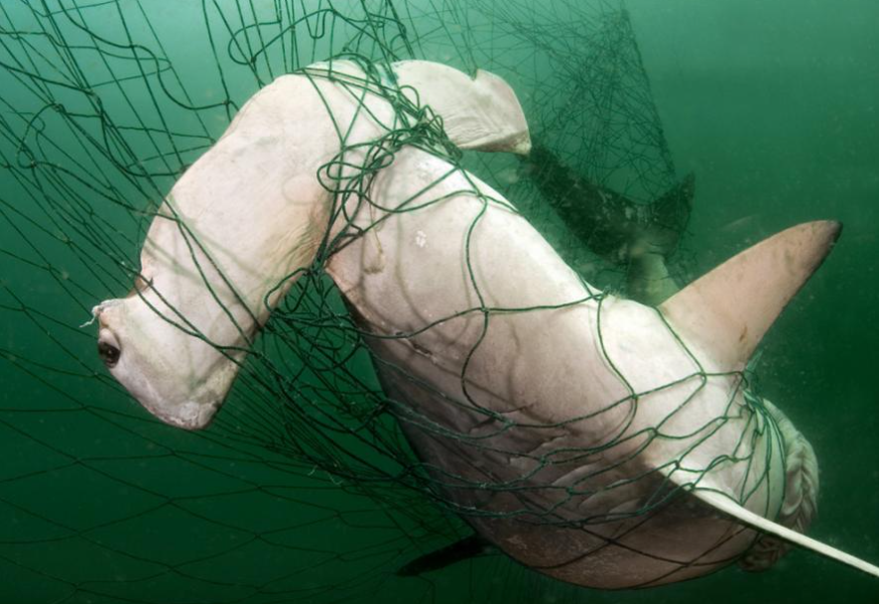

Slide 27
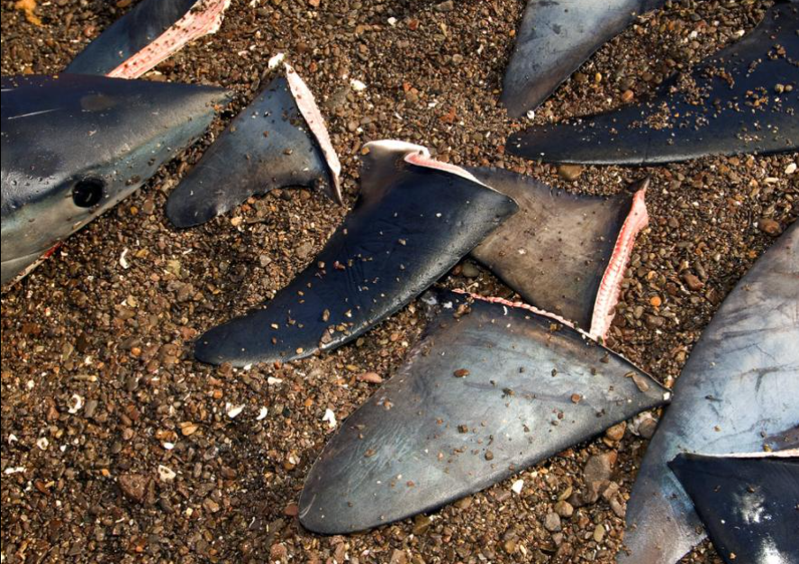

Slide 28
How We CAN HELP… NOW
Notes:
One of the most important things I want to emphasize is our individual abilities to make a difference.

Slide 29
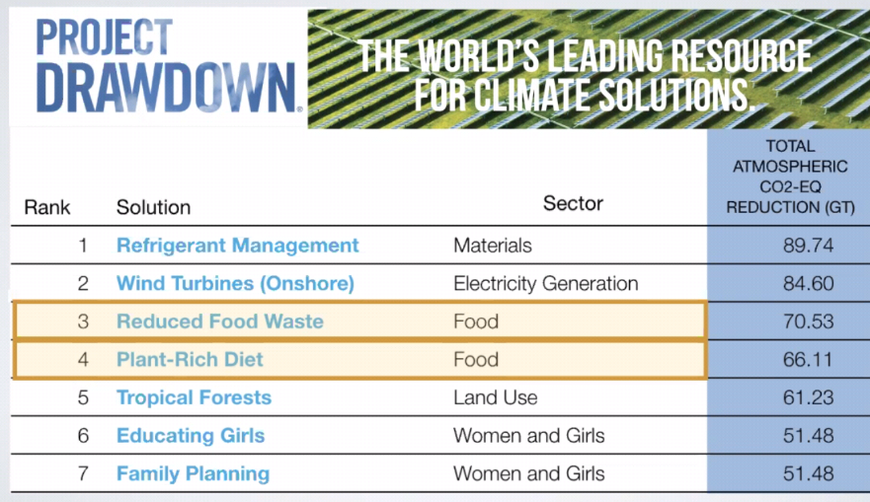

Slide 31
MAKE DAILY CHOICES
Try to Eat Vegetarian! Or Even Vegan
Be a Conscious Consumer – avoid single use plastic. Be aware of the materials you are buying!
Reduce, Reuse, Recycle
Ride Your Bike, Go for a Walk!
Unplug Appliances When Not in Use

Slide 32
GET INFORMED
Take Environmental Science Classes!
Watch Documentaries
Chasing Coral
Blackfish
Mission Blue
Cowspiracy: The Sustainability Secret
My Octopus Teacher
Read Up!
U.S. Navy Diver’s Manual (Link)
Mapping the Deep
We Are the Weather
Eat for the Planet
Follow Movement Leaders
Paul Nicklen (National Geographic)
Ocean Ramsey (Conservationist)
Juan Sharks (Photographer)
Jane Goodall (Primatologist, Masterclass)

Slide 33
Get Involved
Sea Legacy (Link)
The Ocean Conservancy
The Nature Conservancy
Oceana
Project AWARE Foundation
Coral Reef Alliance
World Wildlife Fund
PETA
Greenpeace
The list goes on…

